Slide 1

Welcome
We’ll be starting shortly…
It’s recommended that you use headset for better audio quality

Slide 2

FAIR-by-Design Methodology Session 2 Hands-on
Sonja Filiposka, UKIM
orcid.org/0000-0003-0034-2855

Slide 3
Hands-on Session Agenda
Organisation
Breakout Rooms Focus
Mission: Improve existing learning resource
FAIR-by-Design Methodology – quick recap
Breakout
Max 5-6 people per breakout room
Each room works on different example
Each room has its own instructor
Get together for a debrief
Q&A
Wrap-up
QA check
Learning objectives
RDA min metadata schema
Attribution
Granularity
Accessibility
File Formats
Versioning and Collaboration
Instructor Kit

Slide 4
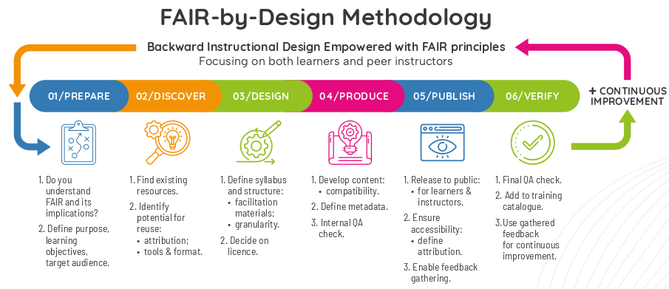
FAIR-by-Design Methodology

Slide 5
Existing Learning Resources Case Studies for our Hands-on Session
Gold, Green, Diamond: What You Should Know About Open Access Publishing Models
https://campus.dariah.eu/resource/posts/gold-green-diamond-what-you-should-know-about-open-access-publishing-models
Introduction to Cultural Heritage Data Modelling — with a focus on Europeana Data Model
https://campus.dariah.eu/resources/hosted/introduction-to-cultural-heritage-data-modelling-with-a-focus-on-edm
Materials from ATRIUM TNA/summer school on LOD
https://petrpajdla.github.io/atRium/
IDCC’25 workshop materials
https://fair-by-design-methodology.github.io/IDCC25workshop/latest/

Slide 6
Breakout Rooms Workspace
Google Drive Folder
Each breakout room has a subfolder to work in
If you decide to work together as a group write directly in the provided document
If you decide to work individually, copy paste the template and rename it with your name

Slide 7
Move on to breakout room

Slide 8
Step 0: Get familiar
Get to know the people in your room
Decide if you are going to work together or individually
Get to know the existing material

Slide 9
Step 1: Perform QA check
Based on the QA guidelines and checklists developed by Skills4EOSC
General QA checklist
focuses on the learning materials content and analyses it from a learners' perspective
FAIR-by-Design QA checklist
focuses on the FAIR aspects of the learning materials and requirements imposed with the use of the methodology
Use the provided excel file and analyse the checklists score

Slide 10
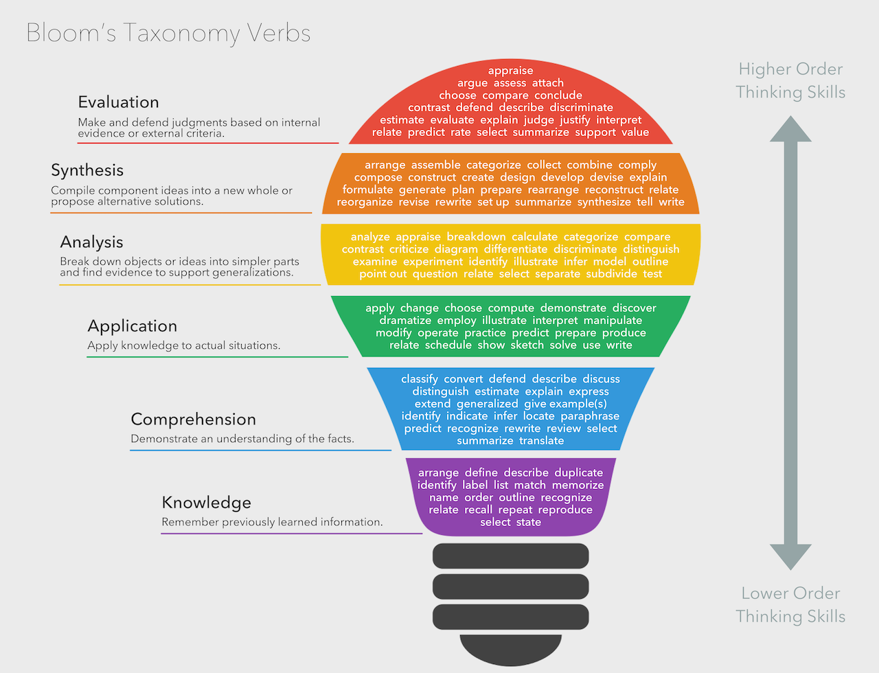
Step 2: Revise Learning Objectives
Bloom's taxonomy by Fractus Learning. (2023, July 10). In Wikipedia licensed under the terms of CC BY-SA 4.0.

Slide 11
How to make SMART learning objectives
Specific
Clearly define what the learner will achieve. Avoid vague terms like “learn” or “understand.”
✗: “Learn about Open Access publishing.”
✓: “Identify and describe the differences between Gold, Green, and Hybrid Open Access models.”
Measurable
Use criteria to track progress and determine when the goal is achieved.
✗: “Understand Open Access policies.”
✓: “List three key funder Open Access requirements and explain how to comply with them.”
Achievable
Ensure the objective is realistic given the resources, time, and learner’s abilities.
✗: “Convert all previous publications to Open Access in one month.”
✓: “Locate an Open Access repository and submit one preprint of your current research within two weeks.”
Relevant
Align the objective with the overall learning goals and learner’s needs.
✗: “Memorize the history of Open Access.”
✓: “Explain how Open Access supports the principles of Open Science and increases research impact.”
Time-bound
Specify a deadline or time frame for achieving the objective.
✗: “Adopt Open Access practices.”
✓: “Develop an Open Access publication strategy for the next research project by the end of the semester.”

Slide 12
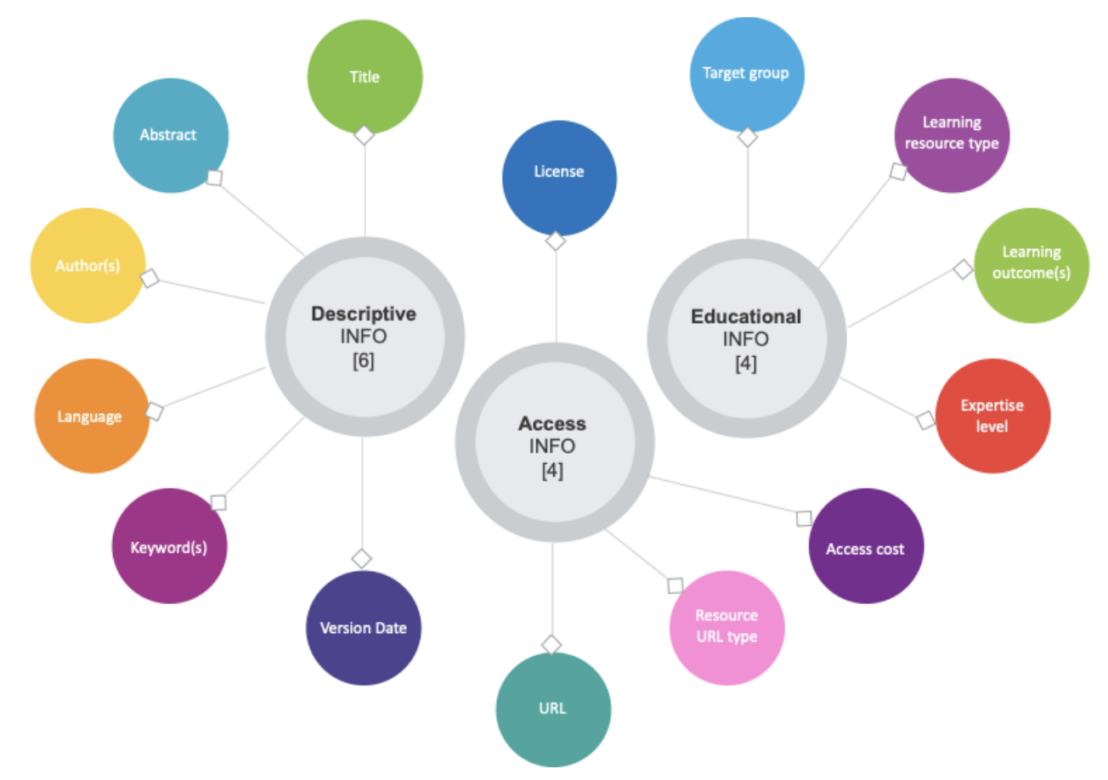
Step 3: Use the RDA Minimal Metadata for Learning Resources
Minimum set of metadata for learning resources by Hoebelheinrich, Nancy J, Biernacka, Katarzyna, Brazas, Michelle, Castro, Leyla Jael, Fiore, Nicola, Hellström, Margareta, Lazzeri, Emma, Leenarts, Ellen, Martinez Lavanchy, Paula Maria, Newbold, Elizabeth, Nurnberger, Amy, Plomp, Esther, Vaira, Lucia, van Gelder, Celia W G, & Whyte, Angus. (2022). Recommendations for a minimal metadata set to aid harmonised discovery of learning resources on Zenodo licensed under CC BY 4.0

Slide 13
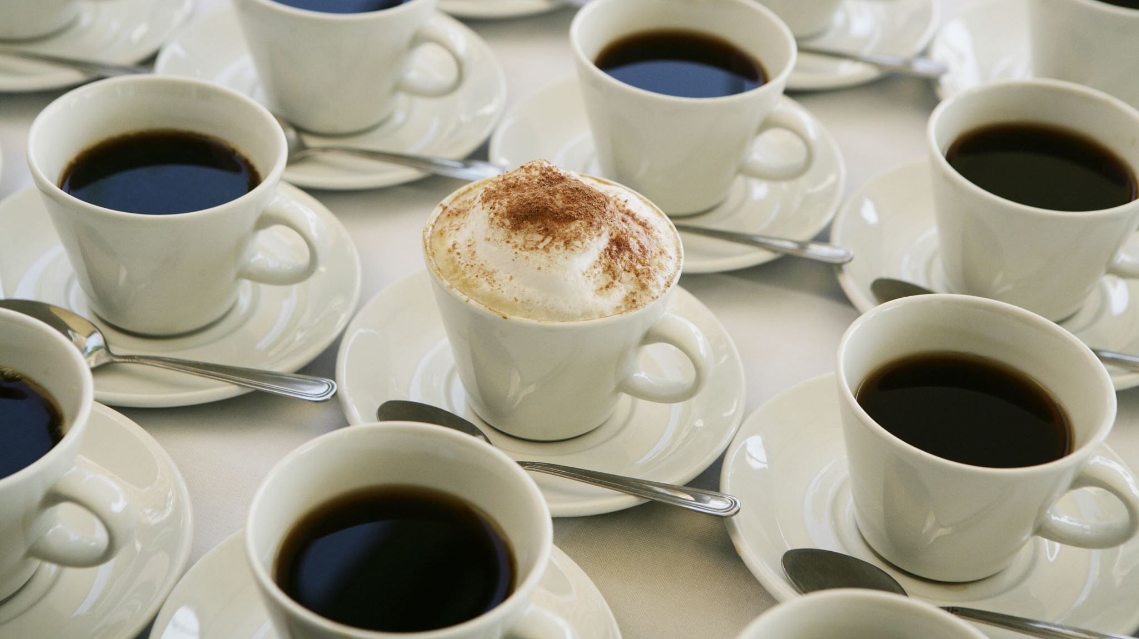
Break ~ 20 mins

Slide 14
Step 4: Check attribution
The ideal attribution = TASL
Title - what is the name of the work
Author - who allows you to use the work (name and link)
Source - where can the work be found (link added to title)
License - how can the work be used (name and link to the license)
CC Recommended practices for attribution
Title
Author
Source
License

Slide 15
Attribution examples
Image attribution
"Creative Commons 10th Birthday Celebration San Francisco" by Timothy Vollmer is licensed under CC BY 4.0
Adapted image attribution (if derivatives are allowed)
"Creative Commons 10th Birthday Celebration San Francisco" by Timothy Vollmer is licensed under CC BY 4.0 / Cropped from original
Text attribution
This chapter is from “You Don't Know JS Yet (2nd Edition)” by Kyle Simpson. The book is licensed under the CC BY-NC-ND 4.0 license. © 2019-2022 Kyle Simpson.
Provided by source
Image by AUTHOR(link) from Pixabay(link)

Slide 16
Step 5: Think granular
Root
resources
questions file
(opt) 01 Section
(opt) 01 Module
01 Learning Unit
Activities
01 activity details
...
N activity details
Assessment
question bank
(opt) strategy
Learning content
Slide deck
Learning unit plan
...
N Learning Unit
syllabus
facilitator guide
README
LICENSE
CITATION
CODE-OF-CONDUCT
Feedback

Slide 17
Step 6: Check/Create alternative text
Alternative text guide by WebAIM
should be accurate and equivalent in representing content and function
should be concise
do not make it redundant
do not include phrases such as "image of ..." or "graphic of ..."
Decorative image = blank alternative text
does not present important content
is used for layout or non-informative purposes
does not have a function (e.g. is not a link)

Slide 18
Ensure accessibility
Check web accessibility with LERA (or similar)
https://advancedbytez.com/lera/
PDF accessibility check with axesCheck
https://check.axes4.com/en/
Image contrast checker
https://www.poper.ai/image-color-contrast-checker/

Slide 19
Step 7: File Formats, Versioning, Collaboration, Instructor Kit
Check/Decide on Open File Formats
Editable formats to be available for other instructors
Final formats for learners
How will both types be versioned
When publishing
While developing
Define collaboration
Internal during development
External, after publishing
Design a suitable Instructor Kit
Make a list of missing items
Review templates

Slide 20
Instructor kit
learning unit plan
activity details
assessment
facilitation guide
feedback questions

Slide 21
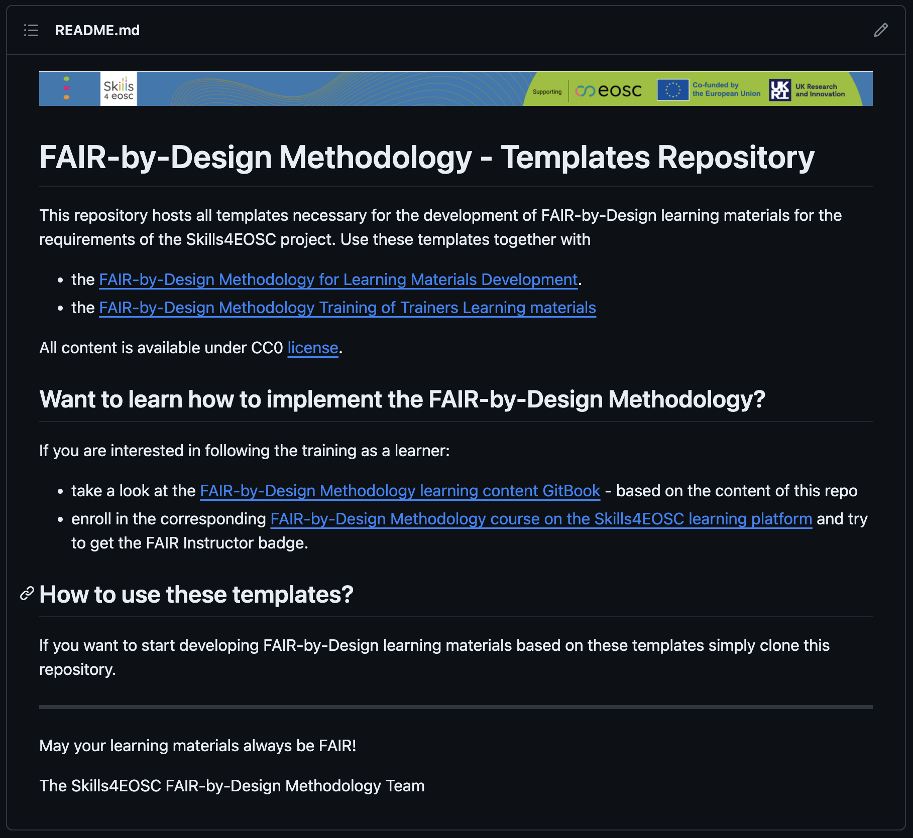
Templates Repository
https://github.com/FAIR-by-Design-Methodology/templates

Slide 22
Q&A
debrief

Slide 23

Thank you!

